Slide 1
Revolved Boss/Base
Solidworks, a tutorial

Slide 2
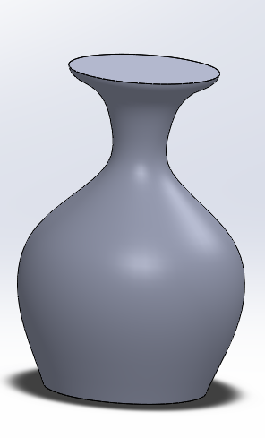
Revolved boss/base
The Revolved boss/base feature is a very usable tool when it comes to creating circular 3D-models such as a vase or a bottle. Anything circular.
The Revolved boss/base is based on a centerline. You then draw the contour of half your part so the feature knows how the part is supposed to look when it rotates about your centerline.
In the following tutorial you will learn how to operate the Revolved boss/base feature of the Solidworks software.
I will during this presentation make a vase.

Slide 3
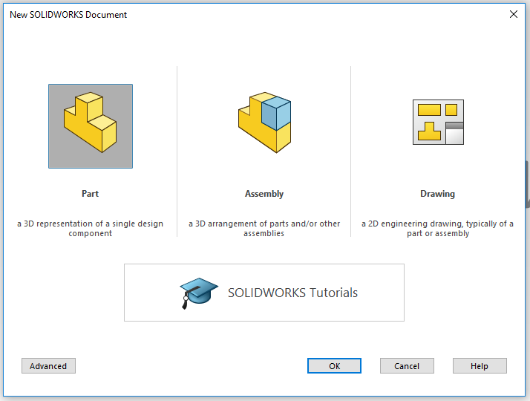
Open SolidWorks
Start by opening the program SolidWorks.
Open a New Dokument.
Click on Part.
A new Solidworkspart will open.

Slide 4
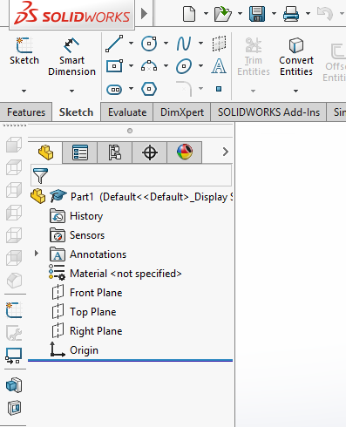
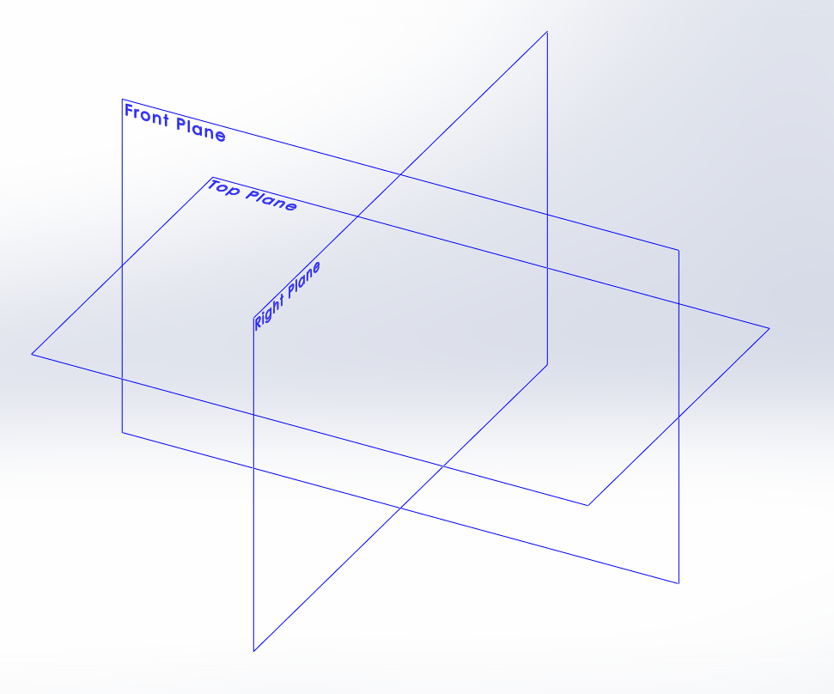
Sketch your part
Click on the tab Sketch in the Command Manager toolbar. All sketch tools will be shown. (As the picture to the right)
Click the icon Sketch.
In your area of drawing, three planes will be shown as in the picture below. Front plane, Top plane and Right plane. Think of them as (Front plane) a front wall in a room, (Top plane) the floor in the room and (right plane) as the right wall.
Pick the plane you need by clicking on it..

Slide 5
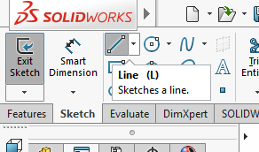
Sketch your Centerline
I chose the front plane for my specific part.
In this case we are going to start by using a Line. Click on the tool Line. Always base your sketch on the origo in your drawing area like i did in the picture. It will make sure that your sketch is fully defined when you measure it in the next step. So click on the origo and drag the line upwards. If the line is vertical you will get that little yellow box with a vertical line in it.
Now it´s time to give your sketch the right measurements. Klick on the tool Smart Dimention. Click on the line you want to measure. And then click besides the line and a pop-up window will show, here you enter the value you want the lenght of the part to be. I will have my vase 300mm heigh.

Slide 6
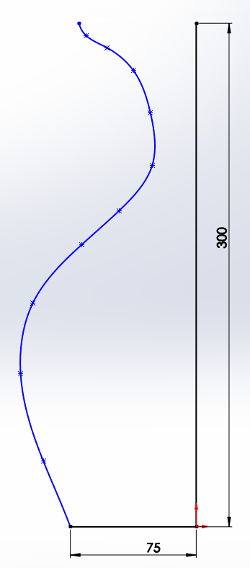
Giving your part its shape
Now that you have the Centerline to work your contour from it´s just to begin creating. You can use almost any sketchtool you want. I will add a straight line (with the tool line) at the bottom to get a flat surface for my vase to stand on. I draw that line and add measurement with Smart Dimentions.
I then use the tool spline to give the vase soft curves. In this step you can go on using any tool you want. The spline tool cannot be measured so you never use that one when you need a part to be exact.
I then draw a line (with the tool line) from the top of my centerline to the top of my spline to get a closed contoure.

Slide 7
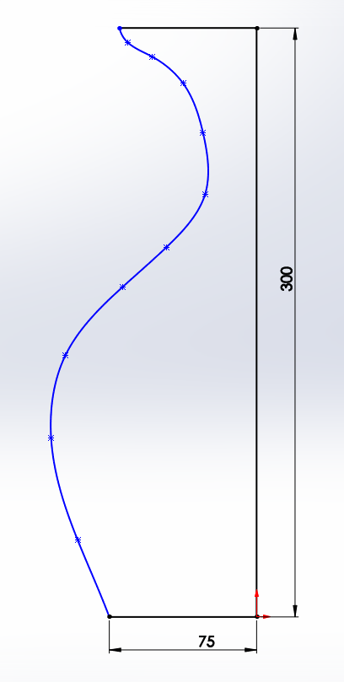
Finishing a Sketch
When your Sketch have a closed contour it is fininshed. (if you have made a sketch completely with straight lines make sure to give the lines all the measurments needed. When all the lines turn black you have made the sketch fully defined). If you have a blue line it means that some measurement is missing and if you have a red line you have the same measurement twise or more. Since i have a spline in my sketch i can´t measure it and it will be blue.
Before we finish make sure your sketch is a closed contour so there isn´t any holes in it. If there is any openings in the sketch the feature Revoled boss/base will not work.
Now the Sketch is done and we will accept the sketch by clicking the icon Exit Sketch. You will find it up in the left corner where you opened your sketch in the begining.

Slide 8
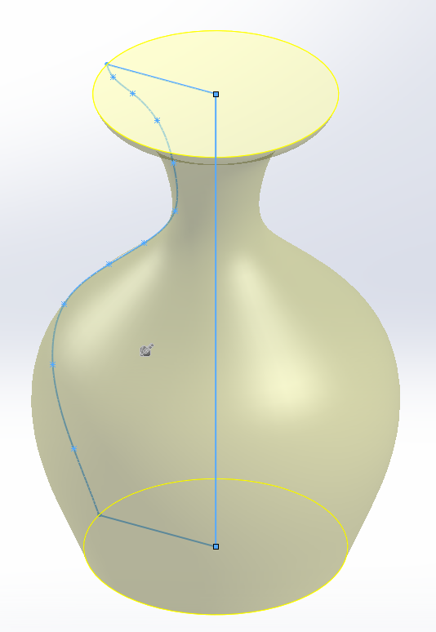
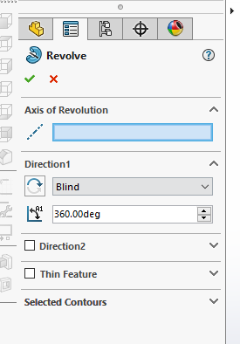
Revolved Boss/Base.
Click on the tab Features. Click on the icon Revolved Boss/Base. The toolbar of the feature revolved boss/base will open at the left side and you ask you to specify what line is your centerline. Click in the box that says Axis of Revolution and then click on your Centerline. Generally the part should now appear in a 3D-view like the picture to the right.
In the toolbar to the left you can decide how many degrees you want your part to turn. It is predecided that it should be 360 Deg. But if you want you part to be sliced into a half you can make it 180 deg.. And so on.
Then click on the green ok button to finish.
Finished Boss/Base

Slide 9
If there should be a hole in your Part
In order to continue to work on your part you can do almost anything. You can add material or remove material.
If you wish to add a hole you can either add it with a new feature. Extruded boss/base or the Revolved Cut which works exactly like the Revolved Boss/Base.
Or you can add your hole into the original sketch you made. I will show you how to do this by editing your sketch.

Slide 10
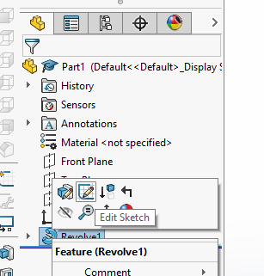
Editing your sketch
In the toolbar to your left you will find your feature named Revolve1.
Right-Click on it and a new tab will open.
Click on the icon that says edit sketch. And your sketch should open.
Click Ctrl+8 and the sketch will turn towards you.

Slide 11
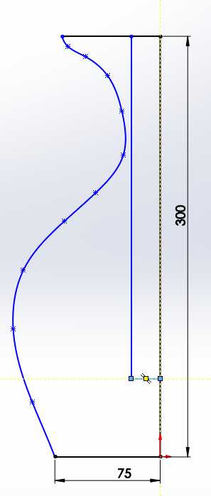
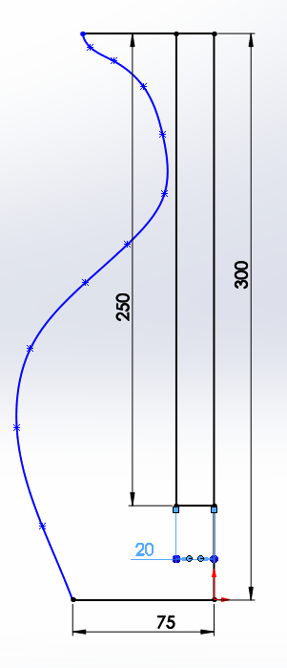
Making the hole
Now, depending on what kind of hole you want you can either draw a hole and measure it or you can use the tool Offset Enteties if you want to have a hole that mirrors the outside of the vase.
I will show you both ways.
If you want a specific hole with a specific diameter and depth you draw a square with the tool (Line) from the horizontal line at the top, straight down, and then connect it with the centerline.
Then measure with Smart Dimension so that you have the measurements that you want. I gave the hole-depth 250mm and the hole-radius 20mm.

Slide 12
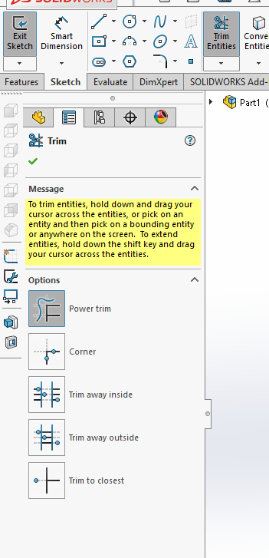
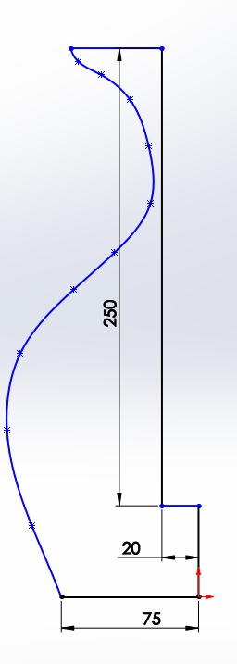
Power-trim
Now you use the tool Trim Entities, Power trim and cut the lines you don´t want out.
I trimed a part of the centerline and a part of the top horizontal line off.
You use the tool by clicking besides the line you want to erase and drag the curser across the line with the left mouse button pressed.
Now that you have erased the lines you click Exit sketch and the part should have a hole in it.

Slide 13
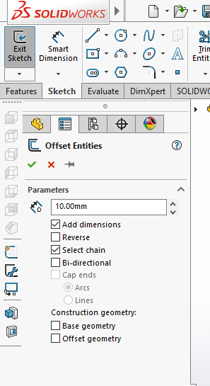
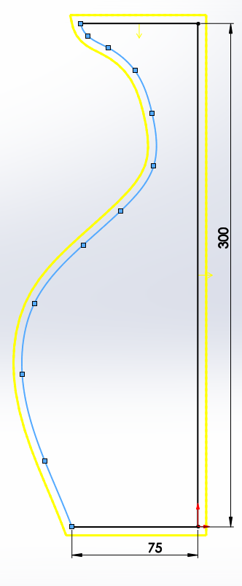
Offset entities
Do the ”editing your sketch” part of the instruction.
Then you click on the Offset Entities sketch-tool and the toolbar should open on your leftside.
In the toolbar you can decide how and where you want your new line to be. I want my line to be 5mm offset from my original line so I add that value into the Parameters. And as you can see on the picture my new line (the yellow one is placed outside my original line and since I want it on the inside I click on Reverse in the toolbar.
And then click the green ok.

Slide 14
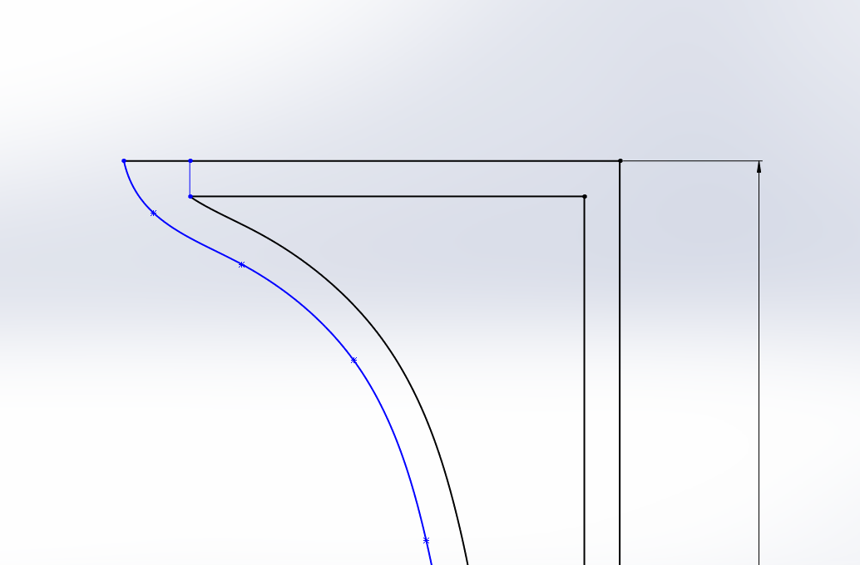
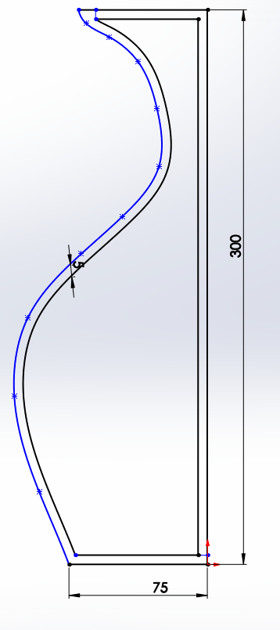
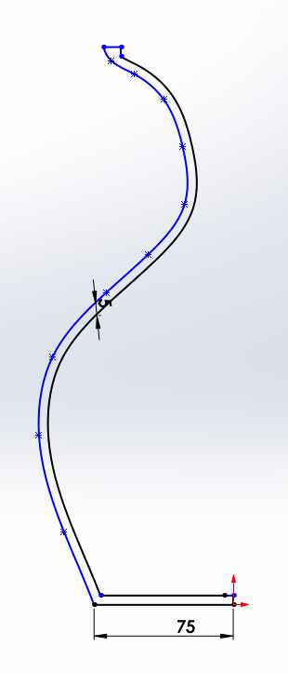
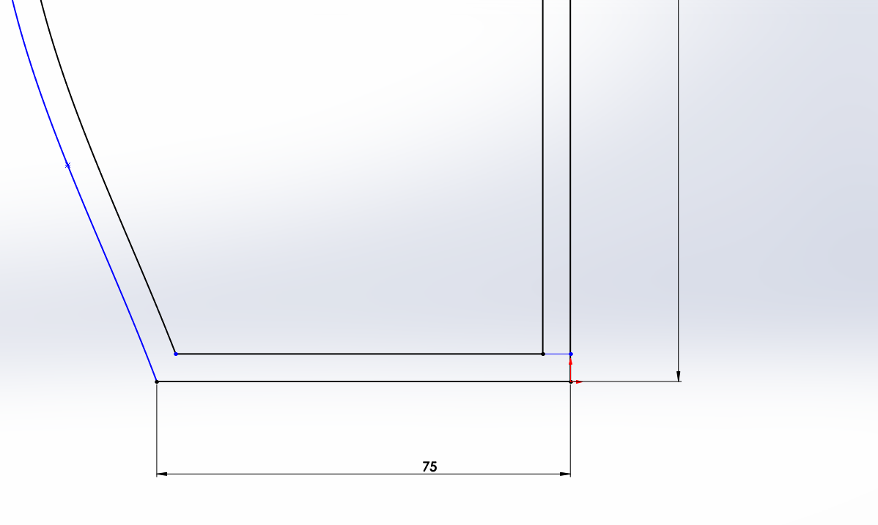
Edit the Offset Entities
Now I have a new contour inside of my old one. I need to edit that contour so I only have one.
I draw lines between the old contour and the new one where I want them to connect. I then use the power trim tool like I showed you earlier and erase some of the lines. Mostly it´s the centerlines and the top horizontal lines. Then it should look like this.
Then you click exit sketch.

Slide 15
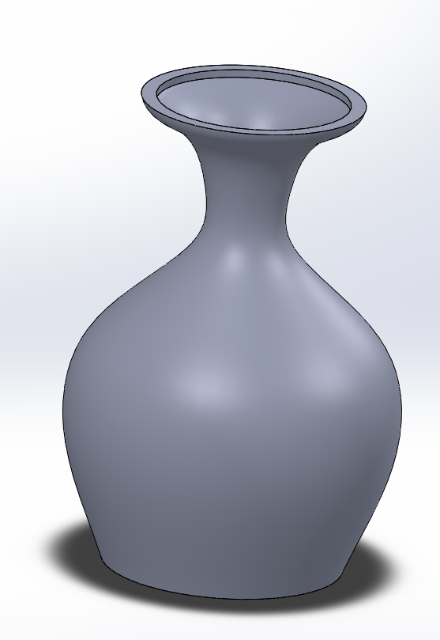
A finished hole
Now the revolve is finished with it´s hole. You can see on the picture how it looks when cut thru.
Good luck ☺

